Slide 1

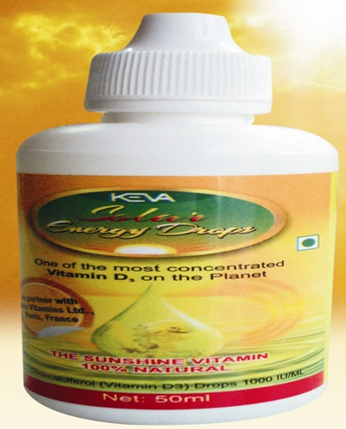
KEVA INDUSTRIES Introduces Keva Solar Energy Drops (KSED)
In Joint Venture With
Miro Vitamins Ltd.
Paris, France

Slide 2

KESD is the unique product produced under GMP Regulations
100% natural drops extracted from seaweed found naturally in France

Slide 3


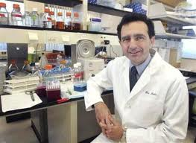
“Eminent Researchers say today deficiency of Vitamin D3 is becoming a crucial health issue worldwide”
Keva Solar Energy Drops is significant to support our daily requirement of Vitamin D3
In India, 90% people are suffering from various chronic disease due to deficiency of Vitamin D3

Slide 4
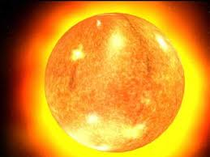
Vitamin D3 is the only Vitamin the body manufactures from sunlight
Due to concern about Skin Cancer we don’t take enough sunlight required for generating Vit.D3

Slide 5





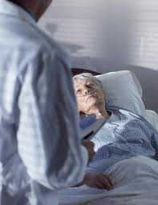
Deficiency of Vitamin D3 can cause
Allergies
Alzheimer’s Disease
Arthritis
Asthma
Autism
Autoimmune Disorders
Bacterial Infections
Bones Fractures
Muscular Disorders
Breast Cancer
Cancer (All Types)
Colds n ‘Flu
Chronic Pains
Dental cavities
misaligned teeth
Depression
Diabetes
Fatigue
Hypertension

Slide 6

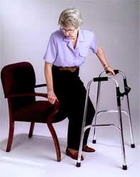

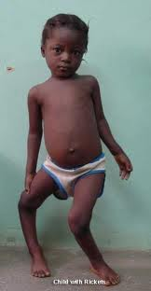
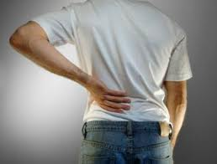
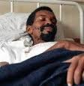

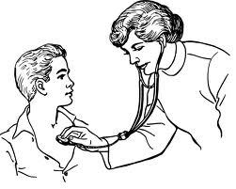
Heart Diseases
Influenza
Kidney Disease
Low Back Pain
Muscular disorder
Mental Illness
Mood Disorders
Multiple Sclerosis
Muscle Weakness
Obesity
Osteoporosis
Parkinson’s Disease
Pelvic Floor Disorders
Pneumonia
Rickets
Infertility
Tuberculosis
Urinary Incontinence

Slide 7


Keva Industry Has Brought The Ultimate Solution KEVA SOLAR ENERGY DROPS (KSED )
How Can We Protect ourselves From These Critical Diseases?

Slide 8


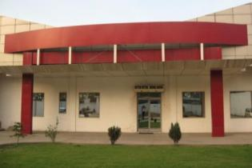
ABOUT KEVA INDUSTRIES Keva Industries is an ISO 9001:2008 certified company which is a leading developer and supplier of wellness and healthcare products in India

Slide 9
About Keva Solar Energy Drops (KSED)
An Effective Health Product useful in Treating Many Chronic Diseases & Gives you 100% Solution to Live in a healthier Way

Slide 10
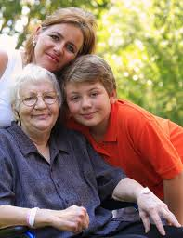

Benefits of Keva Solar Energy Drops
Provides Strong Immune System
Helps in the treatment of Infertility and
improve sperm functioning
Fight Against ‘Cold n Flu’
Rejuvenate Respiratory Problems
Provides Healthy Metabolism in the Body
Fight Against Various Skin Disorders

Slide 11




Provides Healthy Musculoskeletal System
Provides strong and healthy teeth, gums
Fight against Various Fatigues
Prevents From All Types Of Cancer
Helpful in relieving From Stress
Enhances Your Mood
Helpful in treating Mental Disorders

Slide 12


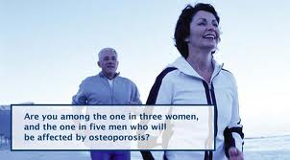
Enhance Neuro-Muscular functions
Helpful in the treatment of Diabetes | and ||
Deals With Chronic Pains, Joint Pains
Heals Muscular weakness and Pain
Fight Against Allergies
Fight Against Bacterial Infections
Helpful in Arthritis
Enhance Life Longevity

Slide 13


Who are most at risk of Vitamin D3 Deficiency?
People most likely to be deficient in vitamin D3 are:
All people who avoid getting sunlight on their skin, or who just stay indoors.
Working people who spent their most of their time in offices and get least sun vitamins.
Older people - as we get older our skin makes substantially less vitamin D3
Blacks and dark-complexioned people,
especially those who live in temperate zones.
Darker skin pigmentation means that it
takes longer (sometimes 4 times longer depending
on the level of skin color) for these individuals to
make vitamin D3 in the skin.

Slide 14



Breastfed Infants. Human breast milk is considered the most perfect nutrition for infants. However, it contains only trace amounts of vitamin D3. This is the reason for the long-standing recommendations for breastfed infants to receive a vitamin D3 supplement.
People who live where sunshine is scarce or
ultraviolet (UV-B) light levels are low
People who always cover up their skin when in sunlight - with clothes or sun block

Slide 15
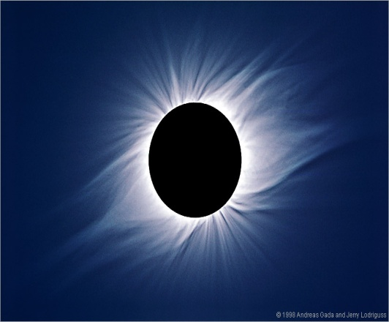
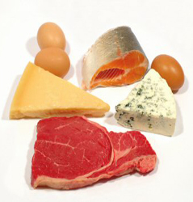
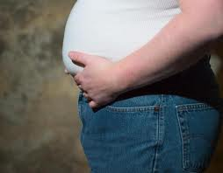
People who only experience sunlight through glass (window glass absorbs the UV-B rays that cause the skin to create vitamin D3)
People who have difficulty absorbing dietary fat. (Vitamin D3 is fat-soluble.) This may include sufferers from Crohn's disease, cystic fibrosis or liver disease.
Obese or heavily overweight people have difficulty building up their vitamin D3 stores, for reasons which are not yet fully understood.

Slide 16


Keva Solar Energy Drops is the best way to help people to prevent themselves from Vitamin D3 loss from body.

Slide 17

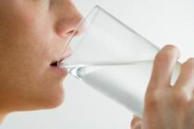
How To Use KSED ?
Age Wise Daily Dosage
Age | Dosage
1 Year | 8 Drops Daily
1-10 Years | 10 Drops Daily
Above 10 Years | 20 Drops Daily

Slide 18


Dos’ & Don’ts while taking kSED
For best results, KSED should be taken daily, as a mandatory dosage.
Mix it with milk or take orally.
Do not mix KSED in any hot drinks.

Slide 19

Dosage can be increased as per body conditions i.e. age, weight etc.
Moderately increased dosages are safe if needed or required but larger amounts may cause a laxative effect.
People suffering from Kidney problems should not take more than 1000 IU per day.

Slide 20


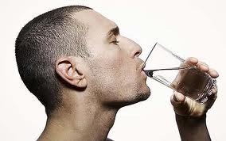
It is extremely essential to drink plenty of water throughout the day. Drink minimum 3 liters of water.
Do not use if the liquid is turbid.
Once opened, consume within 60 days.

Slide 21

Keep the bottle of KSED tightly closed. Store in moderate temperature and avoid direct sunlight.
For better results add KSED daily to your daily diet as a mandatory dosage

Slide 22
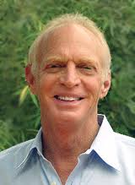

What Doctors say about Vitamin D3?
Sunlight is life. ~ Dr. William Meller, board-certified internist.

Slide 23

It has become increasingly apparent that Vitamin D3 sufficiency is required for optimal health. ~WBGrant and MF Holick

Slide 24

Adults with decreased serum 25(OH)D levels have significantly higher risk of death from HF and premature death, and this may beget additional justification for the study of vitamin D3 supplementation...~ Howard J. Eisen MD, chief of cardiology division at Drexel University College of Medicine, Philadelphia.

Slide 25
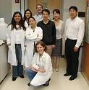
Vitamin D3 truly is the center of the universe. ~ Dr. Russell Chesney, professor and chairman of pediatrics at the University of Tennessee Health Science Center in Memphis
A closer study of the action of solar radiation on the body might well reveal the nature of cancer immunity. ~ Dr. Frank Apperly, concluding remark of his 1941 study on cancer rates vs. latitude.

Slide 26
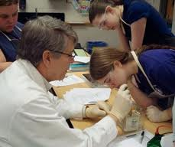
For hundreds of thousands of years, man has lived with the sun: Our ancestors were outdoors far more often than indoors. We developed a dependence on sunshine for health and life, so the idea that sunlight is dangerous does not make sense. How could we have evolved and survived as a species, if we were that vulnerable to something humans have been constantly exposed to for their entire existence?~ Dr. Frank Lipman, internationally recognized expert in the fields of Integrative and Functional Medicine and practicing physician.

Slide 27
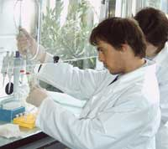
My goal as a physician in our community is to improve the health of of our community, and Vitamin D testing and supplementation is one way to achieve that goal with no adverse side effects and enormous cost savings.~ Jeffrey Dach MD.
Light is the basic component from which all life originates, evolves, and is energized. Light and health are inseparable.~ Ken Ceder, former co-director Hippocrates Health Institute, Boston, Massachusetts.

Slide 28
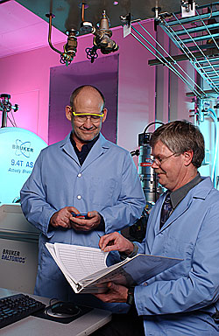
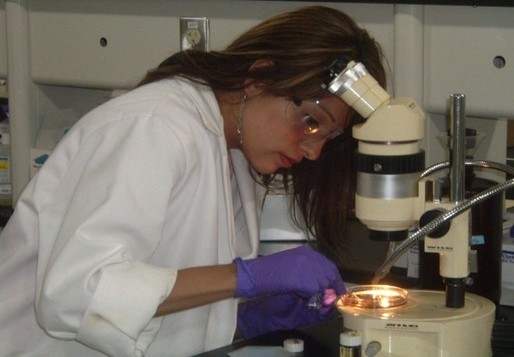
Vitamin D deficiency is an unrecognized, emerging cardiovascular risk factor, which should be screened for and treated. Vitamin D is easy to assess, and supplementation is simple, safe, and inexpensive.~ James H. O'Keefe MD, cardiologist and Director of Preventive Cardiology, Mid America Heart Institute, Kansas City, Missouri.

Slide 29
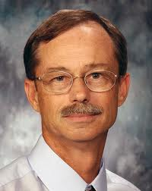
Vitamin D Linked to Fatherhood
Acc. To Dr. Martin Bloomberg Jenson-”Vitamin D levels were positively associated with sperm motility, suggesting a role for vitamin D in human sperm function"

Slide 30



Miro VItamins Ltd is a prominent name in the field of Health Products

Slide 31
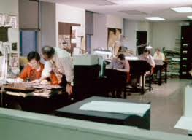
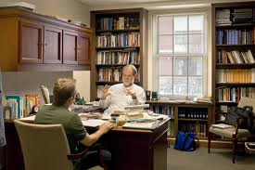
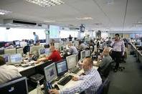
Introducing KSED with Highly Committed & Well- Qualified Staff

Slide 32


Testimonials
Allergy:
I can manage all my skin problems with the help of a very effective and innovative product Keva Solar Energy Drops. I found this product as an ultimate remedy of my skin problem as I was continuously dealing with skin allergy, rashes, itchiness and redness. I want to thank with the bottom of my heart to Keva Solar Energy Team!
Le Martniere
Age-41 Yrs
Kerlouan (France)

Slide 33
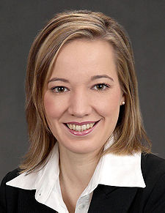
Arthritis
I am a 36 years old business lady. I suffered severe pains in left knee and elbow and right hand. I could not walk and hold objects with my right hand. But Keva Solar Energy Drops made my life much easy and pain free. My heartiest thanx to this marvelous health product!
Michel Bernard
Age-36 Yrs
Rixheim (France)

Slide 34


Keva Industries An ISO 9001:2008 Certified Company Level 2, Prestige Omega, No. 104, EPIP Zone, Whitefield, Bangalore-560066 (India) Web: www.kevaind.org

Slide 35
THANK YOU
Note: This product is not intended to treat, cure or prevent any disease. Please consult your health care professional.

